Slide 1
IMAPS maintain your equipment better
Industrial Machine Parts And Service management

Slide 2
Software description
IMPAS software designed for technical department in order to have all parts and maintenance reports of all machines in the dairy in one database
IMPAS is helping to Service Companies working with dairies to handle many machines and have a one database for all
IMPAS can be sold with a machine as additional tool for maintenance improvement together with machine manual books
With IMPAS the statistic and reporting is easy and handy

Slide 3
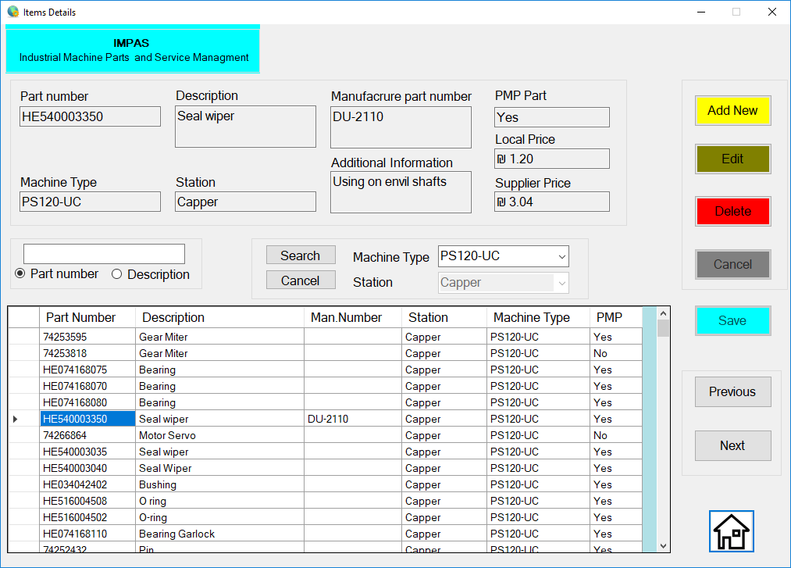
Software features
Full part description including price and custom information
Find part by stations
Search by part number, description or station

Slide 4
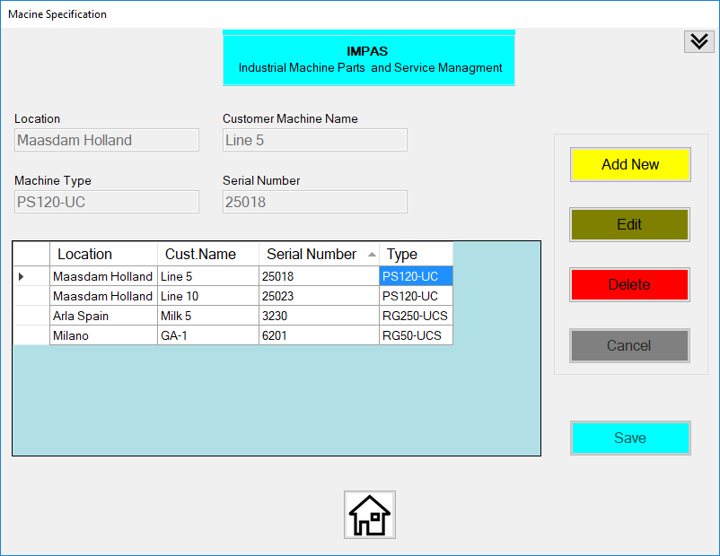
Software features
Locate machines by dairies or place, country or city
Use machine nicknames Like in Dairies

Slide 5
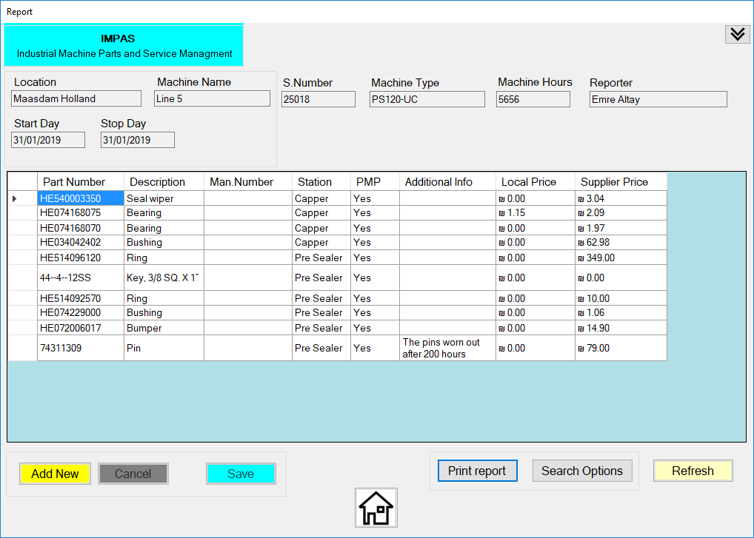
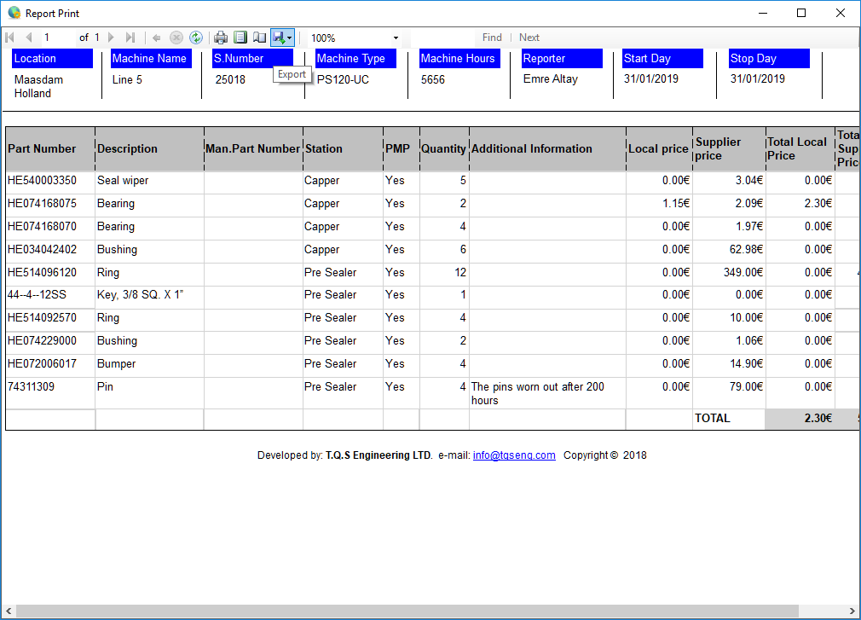
Software features
Prepare reports in easy way
Print reports in different formats
Find reports using many search options

Slide 6
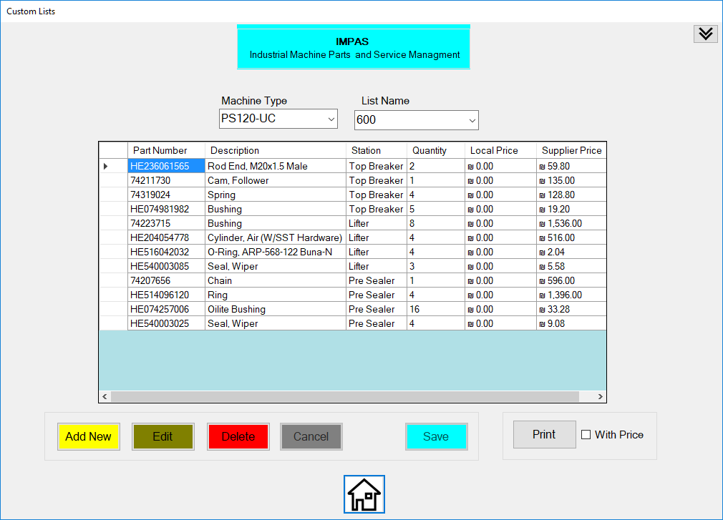
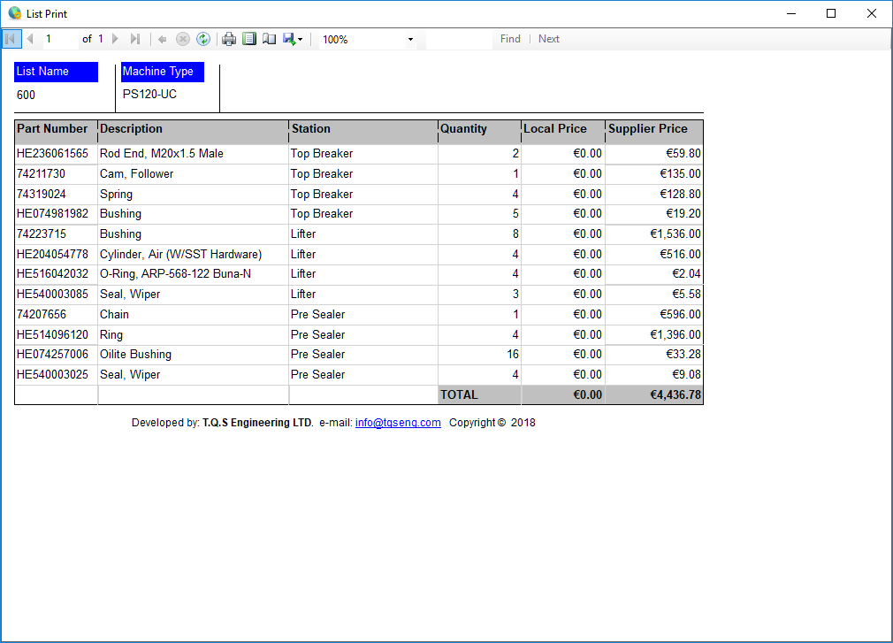
Software features
Make your own maintenance lists
Make a list to see the total price of parts
Print the list for orders or parts collection for maintenance

Slide 7
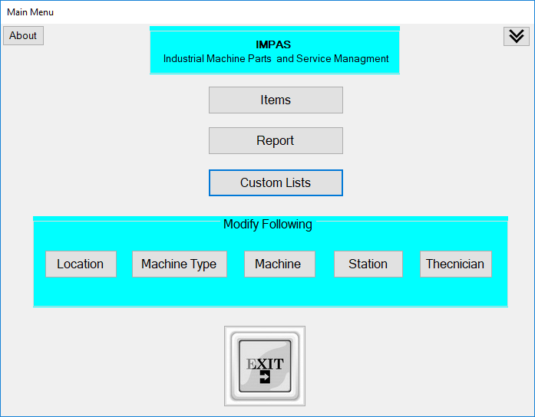
IMAPS Thank you
Industrial Machine Parts And Service management

